Slide 1
[
]
UNLOCKING THE POTENTIAL OF
INCLUSIVE GROWTH AT THE LOCAL LEVEL
Regional forum for social and economic policy
24 - 25th October 2019, Bratislava
Josef Středula,ČMKOS

Slide 2
Where are we?
[
]

Slide 3
Czech labour costs at the level of developing eu countries
International comparison of labour costs in eu countries in 2018
Non-wage
Wage
Česká republika
France
Austria
Ireland
Cyprus
Poland
Belgium
Finland
Greece
Portugal
Bulgaria
Czechia
Slovakia
Latvia
Sweden
Spain
Estonia
Hungary
Italy
Slovenia
Lithuania
Luxembourg
Netherlands
UK
Croatia
Romania
Denmark
Germany

Slide 4
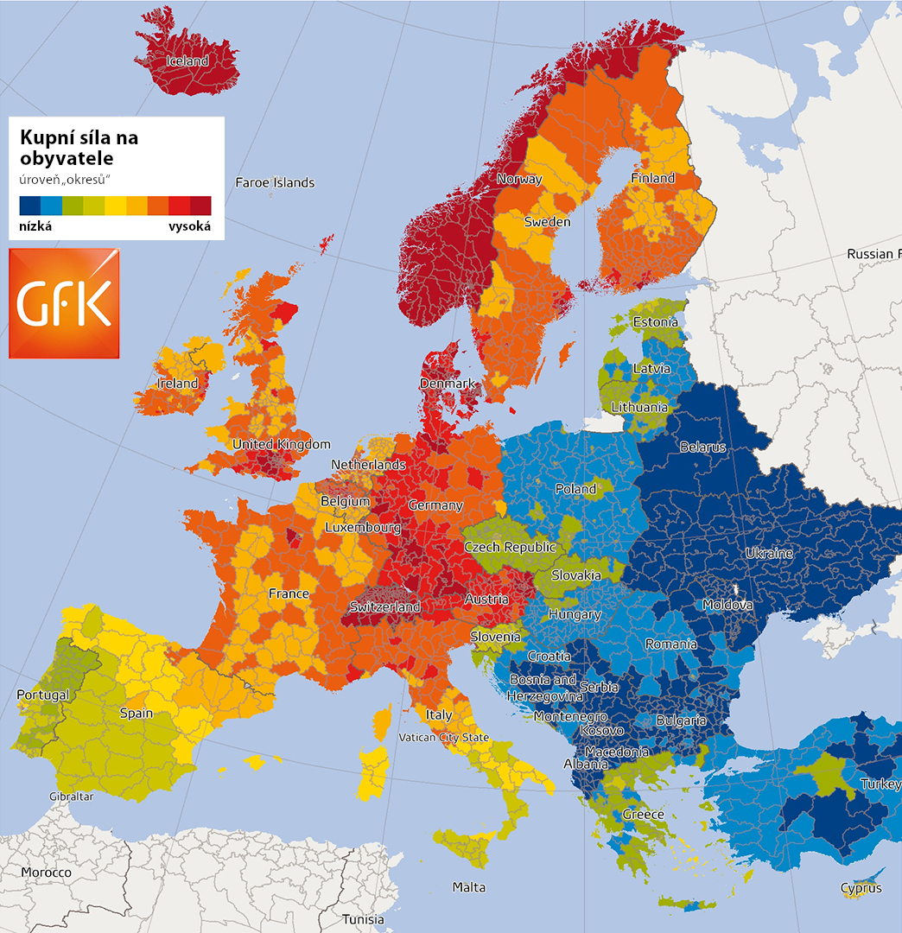
Purchasing power
per capita
Low
High
Česká republika

Slide 6
Minimum wage is low in €
6th lowest in EU
Česká republika
Ireland
Belgium
France
UK
Poland
Germany
Slovenia
Lithuania
Latvia
Greece
Estonia
Czechia
Hungary
Luxembourg
Netherlands
Spain
Portugal
Slovakia
Croatia
Romania
Bulgaria
Zdroj: Eurostat, 2019

Slide 7
Minimum wage is low in Purchasing power standard
4th lowest in EU
v paritě
Česká republika
Belgium
Ireland
UK
Poland
Greece
France
Slovenia
Hungary
Czechia
Latvia
Germany
Spain
Lithuania
Slovakia
Estonia
Bulgaria
Luxembourg
Netherlands
Romania
Portugal
Croatia
Zdroj: Eurostat, 2019

Slide 8
the level of profits in the EU comparison is relatively high
Operating profit rate - ratio of gross operating surplus and mixed income to gross value added as a percentage of the EU in 2017
of value added
Ireland
Finland
Austria
Denmark
Poland
France
Greece
Cyprus
Latvia
Slovakia
Bulgaria
Portugal
Belgium
Sweden
Hungary
Germany
Romania
Italy
Lithuania
Spain
Estonia
Slovenia
Czechia
Netherlands
Croatia
Luxembourg
UK

Slide 9
The share of Czech wages in the economy is
low compared to the EU
Share of compensation of employees in gross value added as a percentage in the EU in 2017
Denmark
France
Finland
Austria
Cyprus
Poland
Ireland
Slovenia
Belgium
Sweden
Latvia
Portugal
Greece
Germany
Estonia
Spain
Hungary
Bulgaria
Lithuania
Slovakia
Romania
Luxembourg
Italy
Croatia
Netherlands
Czechia
UK

Slide 10
WE are one of two EU countries with the highest capital outflow
Balance of dividend flow from direct and portfolio investment as a percentage of GDP in 2017
Ireland
Austria
Finland
France
Latvia
Poland
Greece
Denmark
Belgium
Portugal
Sweden
Slovakia
Hungary
Bulgaria
Romania
Slovenia
Estonia
Germany
Lithuania
Croatia
Spain
Italy
Netherlands
Czechia
Luxembourg
UK

Slide 11
steady outflow of capital
Outflow of dividends from direct and portfolio investment from the Czech Republic

Slide 12
Policy of cheap labour and low exchange rate
Technological lagging behind
Lower tiers of processing value chains
Lower value added
Lower aggregate labour productivity
Lower wages
Lower product valuation
Middle income trap
Česká republika

Slide 13
National economy support policy
Support of technological advancement
Higher aggregate labour productivity
Higher processing tiers enhancing production finality
Dynamic growth in product valuation (economy as a price maker)
Higher value added
Higher wages
Česká republika
Way to prosperity

Slide 14
New model of cheap labour policy
[
]

Slide 15
The number of foreigners on the labour market is increasing
Total number of foreigners on the Czech labour market
Foreigners with trade licence
Foreign employees
Registered unemployment

Slide 16
Low wages and long working time two faces of retarding Czech economy
[
]

Slide 17
The more to the east, the less money, the more working hours
Labour costs and time worked in EU countries in 2017
Ireland
Austria
Finland
Denmark
France
Ireland
Cyprus
Poland
Belgium
Sweden
Greece
Latvia
Bulgaria
Germany
Slovenia
Estonia
Slovakia
Hungary
Romania
Spain
Lithuania
Luxembourg
Netherlands
Italy
Portugal
Croatia
UK
Czechia
Costs EUR/h
Hours per employed person

Slide 18
Working time | Hours a year worked less than a Czech |  | Working days worked less than a Czech |  | Years in which a worker will work one year less than a Czech |  | How many more years a Czech works in his or her entire working life
 | 2015 | 2017 | 2015 | 2017 | 2015 | 2017 | 2015 | 2017
German | 388 | 424 | 48,5 | 59,4 | 5,2 | 4,2 | 9 | 11
Dane | 349 | 370 | 43,6 | 51,8 | 5,7 | 4,8 | 8 | 10
Dutch | 332 | 349 | 41,5 | 48,9 | 6,0 | 5,1 | 8 | 9
French | 247 | 262 | 30,9 | 36,7 | 8,0 | 6,8 | 6 | 7
Belgian | 211 | 235 | 26,4 | 32,9 | 9,5 | 7,6 | 5 | 6
Austrian | 157 | 167 | 19,6 | 23,4 | 12,8 | 10,7 | 4 | 4
Swede | 146 | 175 | 18,3 | 24,5 | 13,7 | 10,2 | 3 | 5

Slide 19
How to transform the Czech Republic into a country of the future?
[
]

Slide 20
still not at the forefront of the EU in
investment in science and research
R&D expenditure in the European Union in 2017 (% of GDP)
Austria
Finland
Ireland
Sweden
Denmark
France
Greece
Poland
Cyprus
Latvia
Germany
Belgium
Slovenia
Hungary
Estonia
Slovakia
Bulgaria
Romania
Netherlands
Italy
Portugal
Spain
Lithuania
Croatia
Czechia
Luxembourg
UK

Slide 21
#EndOfCheapLabour
is not enough.
What we want is

Slide 22
Česká republika
#GoodWork

Slide 23
